Slide 1
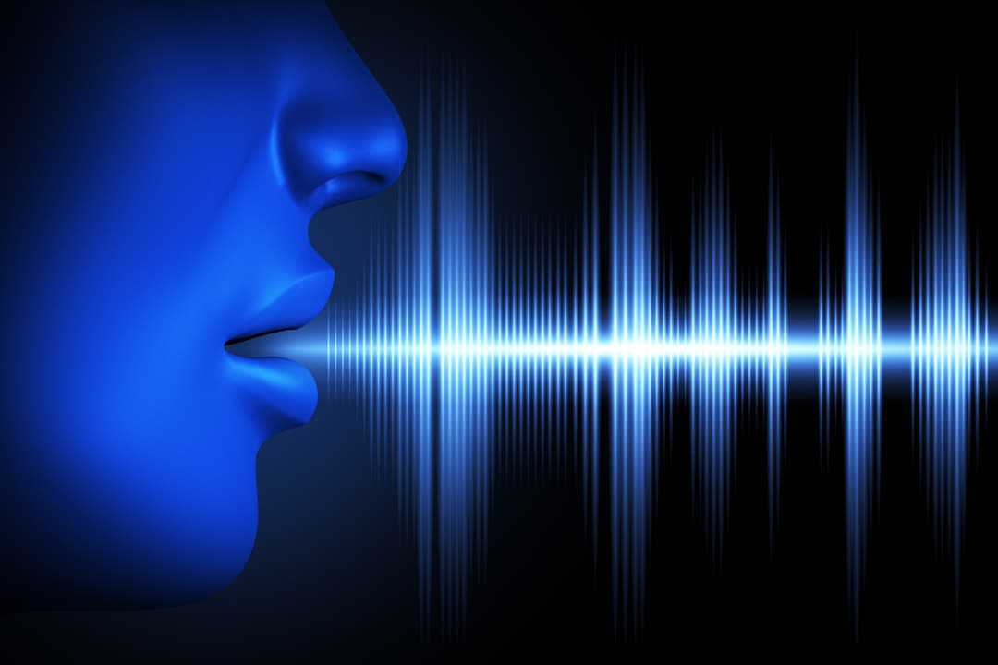
PREDICTION OF PARKINSONS DISEASE USING SPEECH SIGNALS
PROJECT GUIDE:
Mrs. DEEPA P
TEAM MEMBERS:
MADHUMITHA B D(2018PECCS159)
KEERTHIKA S(2018PECCS152)
HARSHINI C(2018PECCS137)
BATCH: DOMAIN:
A14 DEEP LEARNING

Slide 2
INTRODUCTION
Parkinson’s disease (PD) is a degenerative neurological disorder marked by decreased dopamine levels in the brain.
There is commonly a marked effect on speech, including hypophonia (lowered volume), and monotone (reduced pitch range).
Additionally, cognitive impairments and changes in mood can occur, and risk of dementia is increased.
Since there is no definitive laboratory test to diagnose PD, diagnosis is often difficult, particularly in the early stages when motor effects are not yet severe. Monitoring progression of the disease over time requires repeated clinic visits by the patient.
An effective screening process, particularly one that doesn’t require a clinic visit, would be beneficial.
Since PD patients exhibit characteristic vocal features, voice recordings are a useful and non-invasive tool for diagnosis.
If deep learning algorithms could be applied to a voice recording dataset to accurately diagnosis PD, this would be an effective screening step prior to an appointment with a clinician. . The past dataset is collected and that dataset is used to build a deep learning model.
The data is visualized for better understanding of the features and based on that a classification model is built by using deep learning algorithm and comparison of algorithms are done based on their performance metrics like accuracy, F1 score recall etc.

Slide 3
LITERATURE SURVEY
AUTHORS | METHODOLOGY | MAJOR FINDINGS
Christos Laganas (2021) | Running speech recordings | A machine learning-based approach used for collecting voice based data from speech.
Shweta Prasad (2022) | GAT (Graph Attention Network)model | This model is used to generate node embedding's from the structural connectivity matrix.
Mohammed Nasim (2021) | SVM and sparse auto-encoder | SVM integrating with principle component analysis and sparse auto-encoder detect based on features.
Anusri (2021) | CNN(Convolutional Neural Network) | Classifying facial emotions using CNN architecture.
Cherif Adnen(2020) | DNN(Deep Neural Network) | PD detection system based on vocal features was proposed using fully DNN as a classifier.
Srivardhini Veeraragavan(2020) | ANN(Artificial Neural Network ) | Gait features are extracted and ANN model diagnose PD using cross validation.
F.M. Javed Mehedi Shamrat(2019) | KNN (K-Nearest Neighbor) and LR(Logistic Regression) | AI methods are used detection of PD datasets using KNN, and LR.
Ratula Ray (2019) | Decision Tree and LR | Prediction of PD using Ensemble Machine Learning classification using decision tree and LR.
Srishti Grover(2018) | Min-Max Normalization | The deep neural network is designed with input layer, hidden layers and output layer.

Slide 4
PROBLEM DEFINITION
Diagnosis of PD is important in order to provide patients with appropriate treatment and information on prognosis.
However, an accurate early diagnosis can be challenging because the movement symptoms can overlap with other conditions.
Doctors make the diagnosis of PD based on clinical evaluation, interpreting information gained predominantly through history-taking and examination of the patient.
In this project, we describe the training and selection of the deep learning model. Unlike earlier work in this area.
we focus on developing a model that can diagnose Parkinson’s disease from voice.
Also of importance from a clinical perspective, we show that PD can be diagnosed using an intentionally simple CNN model.
Simple models are more likely to generalize beyond their training data and hence are considered more trustworthy for medical diagnosis.

Slide 5
DEVELOPMENT ENVIRONMENT
HARDWARE ENVIRONMENT
Processor -I5
Speed - 3 GHz
RAM -8 GB (min)
Hard Disk -500 GB
Key Board - Standard Windows Keyboard
SOFTWARE ENVIRONMENT
Operating System : Linux, Windows/7/10
Server : Anaconda, Jupyter
Front End : tkinter
Server-side Script : Python

Slide 6
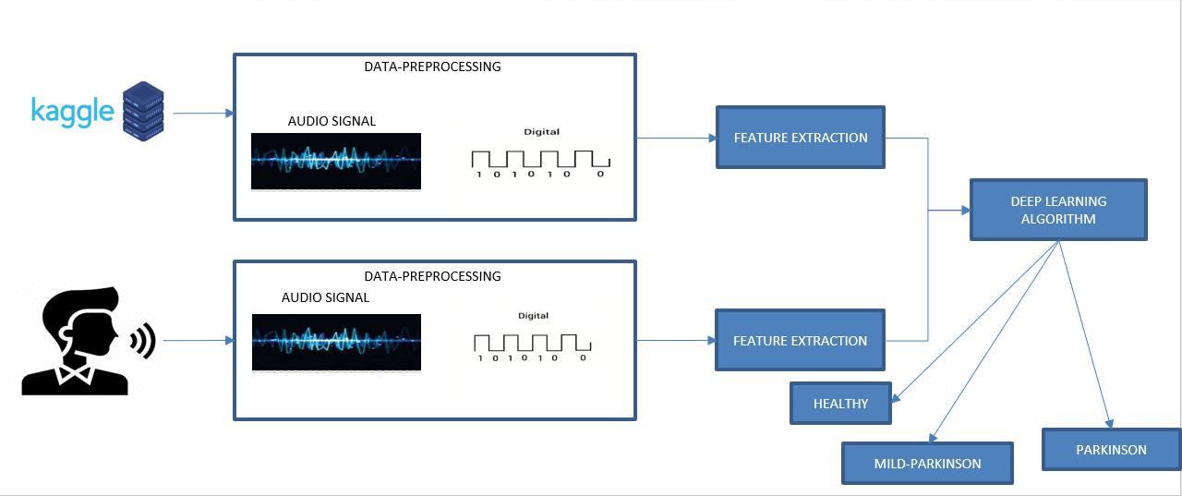
SYSTEM ARCHITECTURE

Slide 7
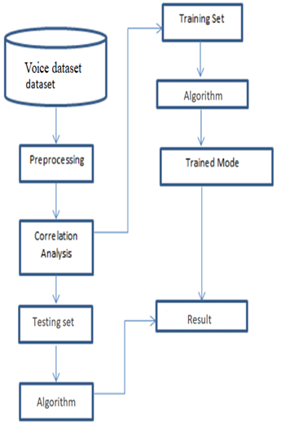
SYSTEM DESIGN DATAFLOW DIAGRAM

Slide 8
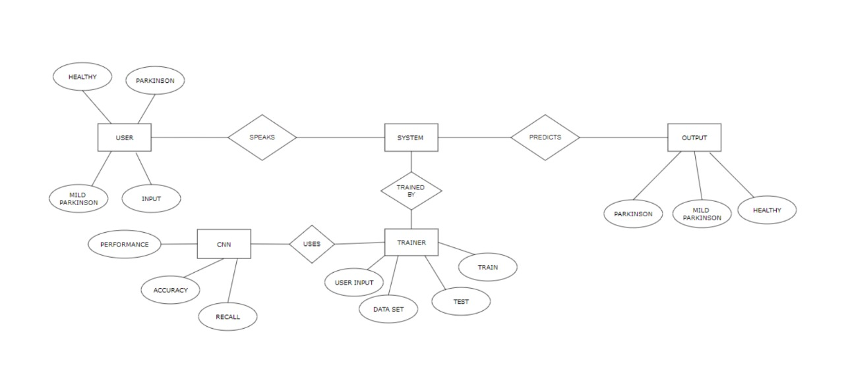
ER DIAGRAM

Slide 9
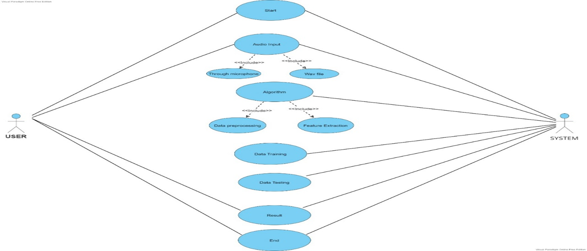
USECASE DIAGRAM

Slide 10
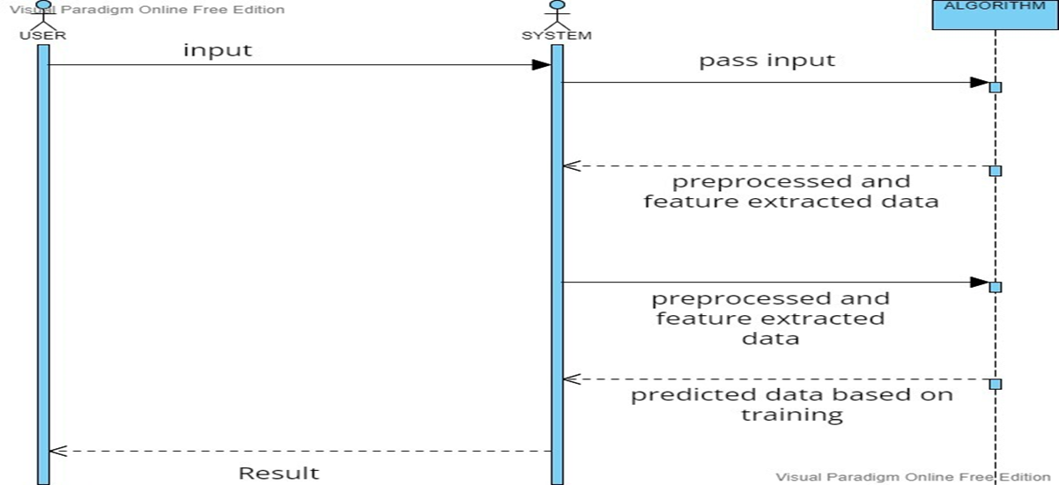
SEQUENCE DIAGRAM

Slide 11
MODULE DESCRIPTION
Data Pre-Processing
Feature Extraction
Classification
Training
Testing

Slide 12
DATA PRE-PROCESSING
Data preprocessing is a process of preparing the raw data and making it suitable for a deep learning model.
It is the first and crucial step while creating a deep learning model.
When creating a deep learning project, it is not always a case that we come across the clean and formatted data.
And while doing any operation with data, it is mandatory to clean it and put in a formatted way. So, for this, we use data preprocessing task.
In our project, a primary microphone is used through which the patients voice is recorded.
The Recorded voice signal retrieved from the patient is converted from analog to digital signal.

Slide 13
DATA PRE-PROCESSING
The mean value of the digital signal is converted into numerical array.
Further, this numerical array is reshaped for the correct fitting for the prediction.
Librosa package in python is used here for audio analysis.

Slide 14
FEATURE EXTRACTION
Feature extraction refers to the process of transforming raw data into numerical features that can be processed while preserving the information in the original data set.
It yields better results than applying deep learning directly to the raw data.
It is the process of selecting a subset of relevant features for use in model construction.
It is also known as variable selection, attribute selection or variable subset selection.
Different voice features such as frequency, amplitude is extracted from digital voice signal obtained from the patient.
Based on these vocal features, diagnosis of Parkinson’s disease is performed. From the audio wave signal obtained, LSTM dense, dropout, activation layers are extracted from higher and lower dimensions.

Slide 15
FEATURE EXTRACTION
In Activation, ReLu function is another non-linear activation function that has gained popularity in the deep learning domain.
ReLU stands for Rectified Linear Unit. The main advantage of using the ReLU function over other activation functions is that it does not activate all the neurons at the same time.
Finally, all these extracted layers are fed into a model and the model is configured for training. The model is compiled with parameters called loss, optimizers and metrics.
Categorical crossentropy loss function is used here with Adam optimizer and accuracy metrics. At last, the compiled model is returned to be used in the algorithm.

Slide 16
CLASSIFICATION
In Deep learning, classification is the problem of identifying to which of a set of categories a new observation belongs, on the basis of a training set of data containing observations whose category membership is known.
Based on the feature selection which is done prior to classification, the patients are classified as Healthy, Mild Parkinson and Parkinson.
In this module we have used three algorithms namely Convolutional Neural Network, Deep Neural Network and Recurrent Neural Network.
Accuracy of the Convolutional Neural Network is greater when compared to deep and recurrent neural network.

Slide 17
TRAINING AND TESTING
TRAINING
The voice dataset of Parkinson affected person and healthy person is collected from Kaggle.
The collected voice dataset is preprocessed and features like frequency, amplitude are extracted.
Based on the features extracted the model is trained.
TESTING
The voice of the user is collected from user interface.
The collected voice is preprocessed and required features like frequency, amplitude is extracted from the voice.
Based on the trained data, the system tests the feature extracted and predicts the health status of person such as Healthy, Mild Parkinson and Parkinson.

Slide 18
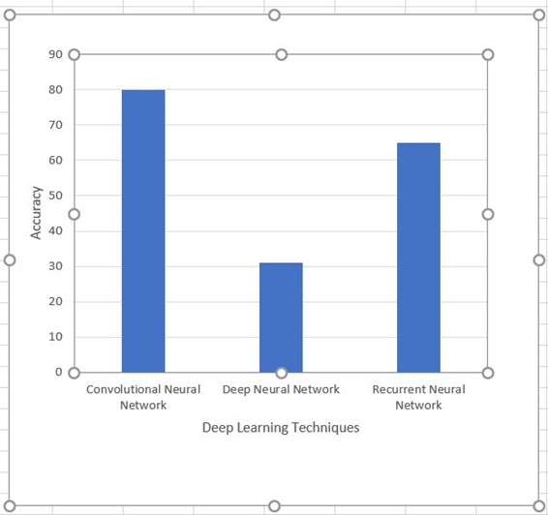
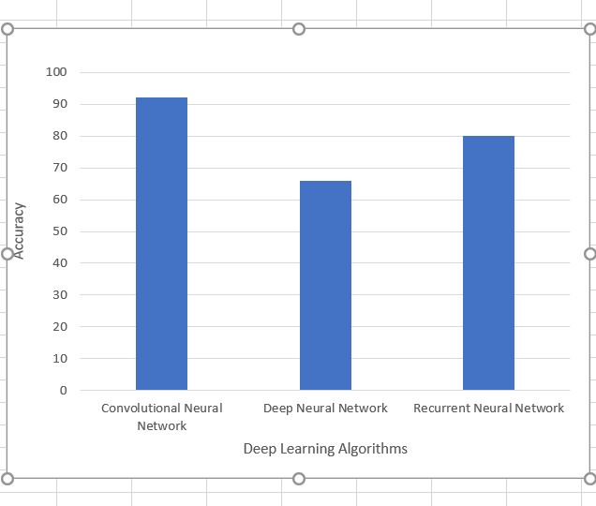
PERFORMANCE EVALUATION
LIVE AUDIO
UPLOAD AUDIO

Slide 19
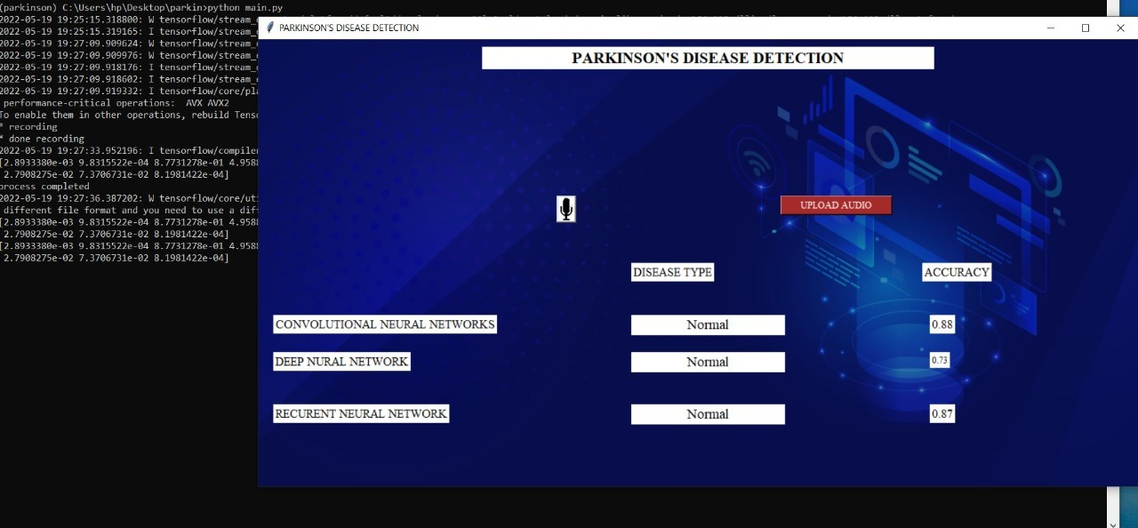
SREENSHOTS LIVE AUDIO INPUT

Slide 20
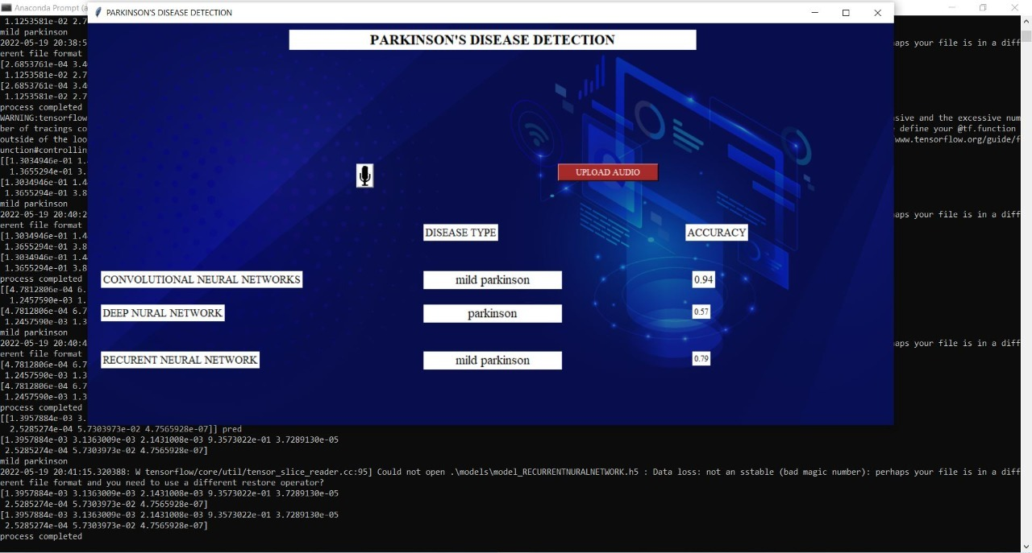
UPLOAD AUDIO INPUT

Slide 21
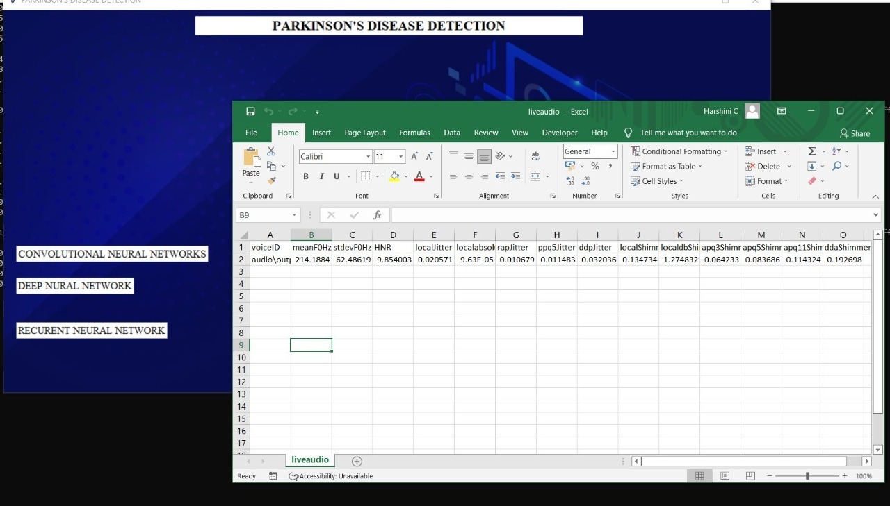
LIVE AUDIO VALUES

Slide 22
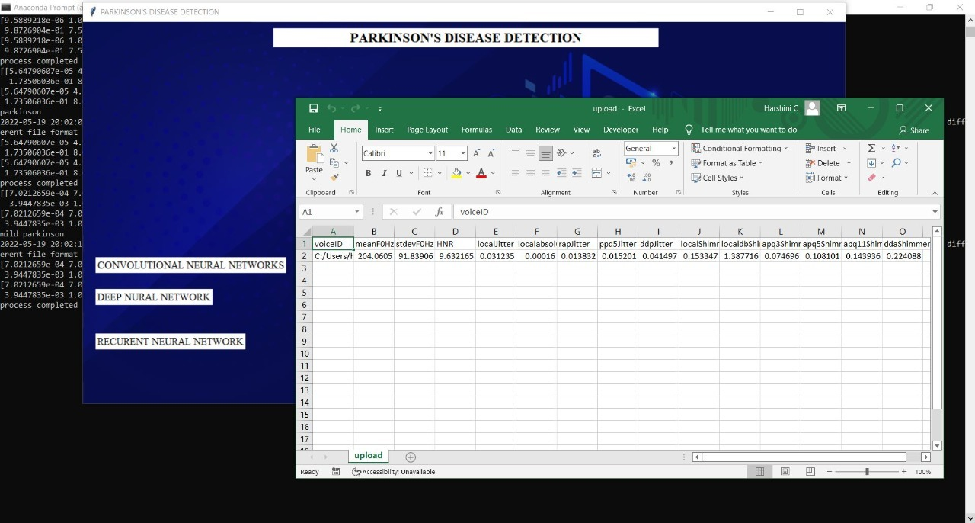
UPLOAD AUDIO VALUES

Slide 23
CONCLUSION
In our project, we've represented three Deep learning approaches. A while after, the performance of the three approaches which are applied in the prognostication of Parkinson disorder.
The conditional performance demonstrations that the CNN has achieved the topmost performance than the other two deep learning approaches within the Parkinson datasets.
In tests, each algorithm was prepared and assessed on a training set that includes healthy, mild-Parkinson and Parkinson samples.
Also, the work can be confirming of Parkinson disorder detection by collecting data from different speech signal and voice datasets and can give more accurate results for disorder prognostication and decision.
We have used three algorithms; it can be preferring further algorithms for developing the precise model of these Parkinson disorder prognostication and performance can be more advanced.

Slide 24
REFERENCES
Christos Laganas, Dimitrios Iakovakis, Stelios Hadjidimitriou, Vasileios Charisis, Sofia B. Dias, Sevasti Bostantzopoulou, Zoe Katsarou, Lisa Klingelhoefer, Heinz Reichmann, Dhaval Trivedi, K. Ray Chaudhuri, and Leontios J.Hadjileontiadis, Senior Member, IEEE(2021) “Parkinson’s Disease Detection Based on Running Speech Data From Phone Calls”, IEEE Transactions on Biomedical Engineering : DOI 10.1109/TBME.2021.3116935,
https://ieeexplore.ieee.org/stamp/stamp.jsp?arnumber=9556632
Ahlem Kehili, dabbabi Karim, Cherif Adnen (2020) “Early Parkinson Detection Using Fully-Connected Deep Neural Network based on Vocal Features “ ,IJCSNS International Journal of Computer science and Network Security , University of Tunis , VOL.20 N0.6 June 2020
https://www.researchgate.net/publication/343100129_Early_Parkinson_Detection_Using_Fully-Connected_Deep_Neural_Network_based_on_Vocal_Features
J. Sujatha, Dr . S.P. Rajagopalan(2017), “Performance Evaluation of Machine Learning Algorithms in the Classification of Parkinson Disease Using Voice Attributes “, International Journal of Applied Engineering Research , India : ISSN 0973-4562 Volume 12, Number 21
http://www.ripublication.com/ijaer17/ijaerv12n21_24.pdf
Srishti Grover, Saloni Bhartia, Akshama, Abhilasha Yadav, Seeja K.R(2018), “Predicting Severity Of Parkinson’s Disease Using Deep Learning”,International conference on Computational Intelligence and Data ,Department of Computer Science and Engineering Indira Gandhi Delhi Technical University for Women, Kashmere Gate, Delhi, 110006, India, Procedia Computer Science Volume 132 , Pages 1788-1794,2018
https://www.sciencedirect.com/science/article/pii/S1877050918308883
Shubham Bind , Arvind Kumar Tiwari , Anil Kumar Sahani(2015),” A Survey of Machine Learning Based Approaches for Parkinson Disease Prediction” (IJCSIT) International Journal of Computer Science and Information Technologies, Department of CSE, KIT, Department of CSE, IIT (BHU) Varanasi, India , Vol. 6 (2) , 2015, 1648-1655
https://citeseerx.ist.psu.edu/viewdoc/download?doi=10.1.1.735.5660&rep=rep1&type=pdf
Amit Kumar Patra , Ratula Ray, Azian Azamimi Abdullah, Satya Ranjan Dash(2019),” Prediction of Parkinson's disease using Ensemble Machine Learning classification from acoustic analysis “, Journal of Physics: Conference Series, IOP publications , UK, Volume : 1372, NO:1742-6596/1372/1/012041
https://iopscience.iop.org/article/10.1088/1742-6596/1372/1/012041/pdf
Apoorva Safai, Nirvi Vakharia, Shweta Prasad, Jitender Saini, Apurva Shah, Abhishek Lenka, Pramod Kumar Pal, and Madhura,” Multi-modal brain based prediction of Parkinson disease using Graph Attention Networks”, Researchgate, Volume : 15 , article :748414
https://www.researchgate.net/publication/358798991_Multimodal_Brain_Connectomics-Based_Prediction_of_Parkinson's_Disease_Using_Graph_Attention_Networks
F.M. Javed Mehedi Shamrat, Md. Asaduzzaman(2019),” A Comparative Analysis Of Parkinson Disease Prediction Using Machine Learning Approaches”, International Journal of Scientific and technology research, VOLUME 8, ISSUE 11, PN.NO – 2576-2580
https://www.researchgate.net/publication/338924577_A_Comparative_Analysis_Of_Parkinson_Disease_Prediction_Using_Machine_Learning_Approaches
Muntasir Hoq , Mohammed Nazim Uddin , Seung-Bo Park(2021),” Vocal Feature Extraction based Artificial Intelligence model for Parkinson disease detection”,Pubmet, 2021 Jun 11 (6):1076. doi: 10.3390/diagnostics11061076.
https://pubmed.ncbi.nlm.nih.gov/34208330/
U Anusri, G Dhatchayani, Y Princely Angelinal and S. Kamalraj(2021) “An Early Prediction of Parkinson’s disease using facial emotional Recognition.”, Journal of Physics 2021 J.Conf. Ser. 1937 012058
https://iopscience.iop.org/article/10.1088/1742-6596/1937/1/012058

